Slide 1

IPL ANALYSIS
By-
KAYATHRI N
21/PMTA/006

Slide 2

Analysis on IPL data
DATA CLEANING
ANALYSIS
INFERENCES

Slide 3


Slide 4
introduction
The Indian Premier League (IPL), also officially known as TATA IPL for sponsorship reasons, is a professional men's Twenty20 cricket league, contested by ten teams based out of seven Indian cities and three Indian states. The league was founded by the Board of Control for Cricket in India (BCCI) in 2007. It is usually held between March and May of every year.

Slide 5
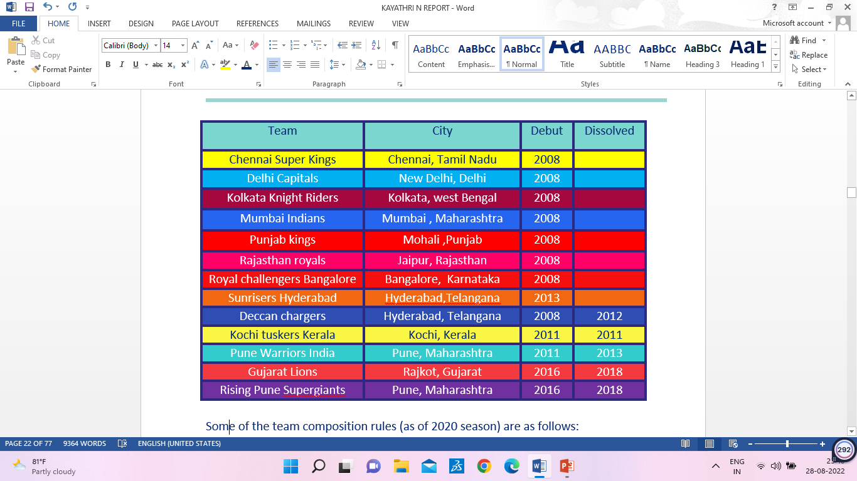
Teams list (2008-2020)
.

Slide 6


Slide 7
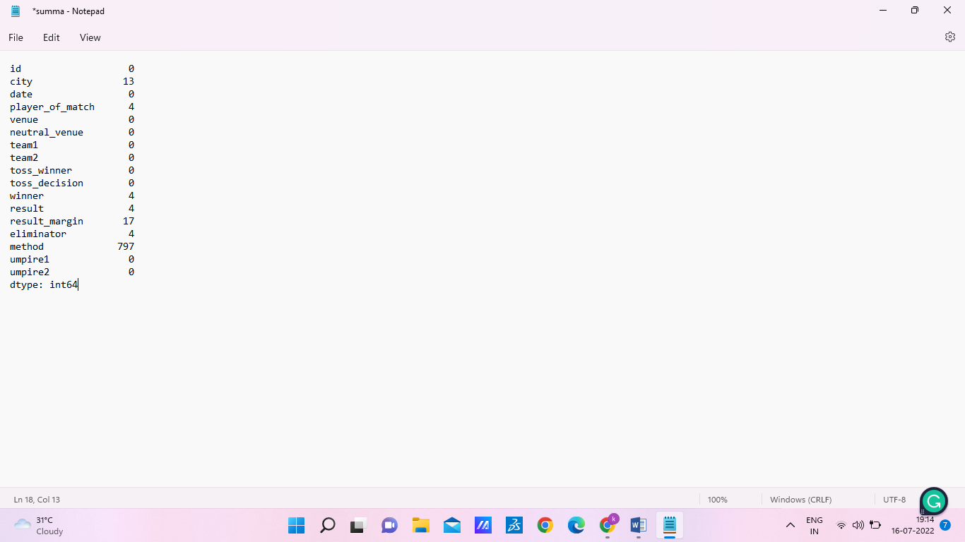
Matches tied due to rain (method) have more NAN value we will be dealing it with a separate data frame. Empty rows in the 'result' column indicate that the match was called off due to rain and hence there is no winner, no eliminator, and no player of the match. we are filling it with none. For the tie matches the result margin is given as nan we are filling it 0.0 as the data type is float. Matches held in stadiums of Sharjah and Dubai have nan values in the city column we will by filling it with corresponding cities.

Slide 8
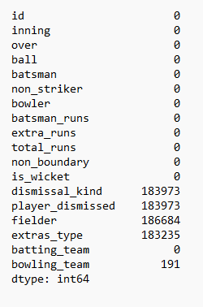
Nan value in dismissal_kind and player_dismissed means no player is dismissed at that ball ,NAN value in extra type refers to no extra run was given at that ball and Nan values in fielder refers to no player is dismissed by fielder(run-out, catch-out or stumping ) so we are filling all the above with none.

Slide 9


Slide 10


Slide 11
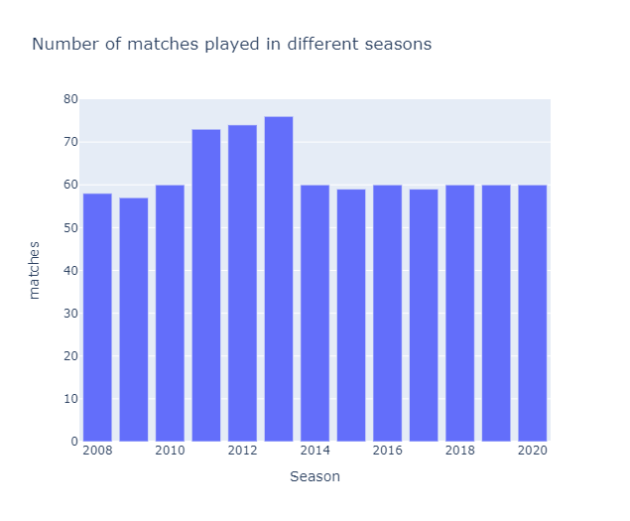
Number of matches played in each season
In 2011 there were 73 matches, in 2012 there were 74 matches, and in 2013 there were 76 matches.

Slide 12
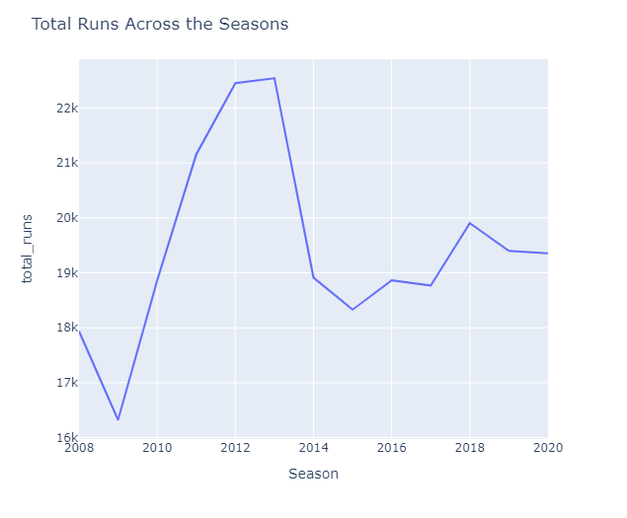
Total runs scored across different seasons
In 2011 there were 73 matches, in 2012 there were 74 matches, and in 2013 there were 76 matches.

Slide 13
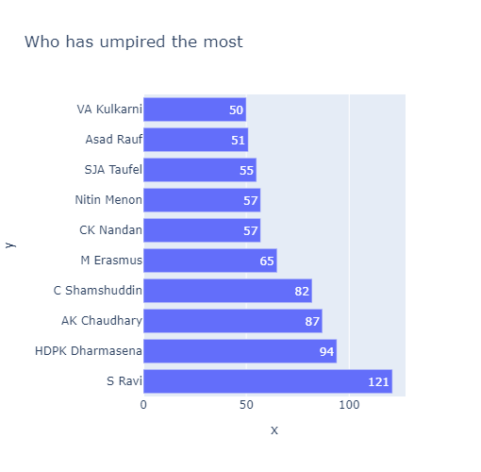
Who has umpired the most?
S Ravi has umpired 121 times and followed by HDPK Dharmasena

Slide 14
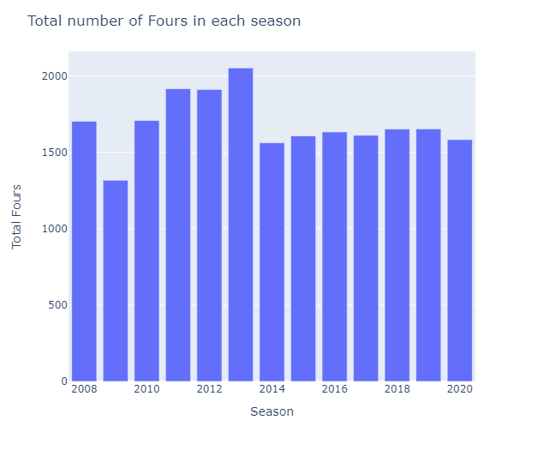
Total number of boundaries in each season
Highest number of four in a season was is 2013 season while season 2009 had the lowest count of 4's

Slide 15
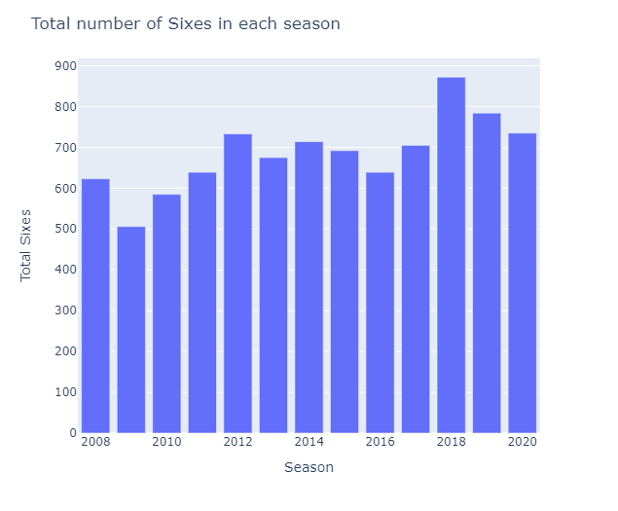
Total number of sixes in each season
In season 2018, the maximum number of sixes were hit while the lowest was observed in season 2009.

Slide 16
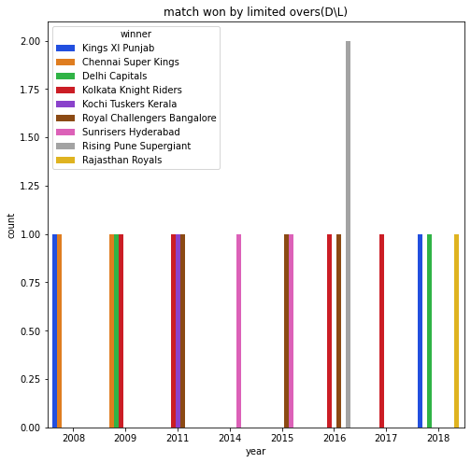
Limited over matches
Out 0f 19 matches Rising Pune Supergiants won 2 matches in limited overs in 2016

Slide 17
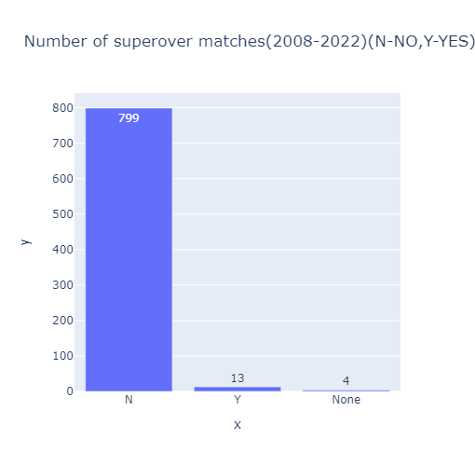
Super over matches
Total matches = 816
Super over = 13
Limited overs = 19
Called off = 4
Normal matches =780

Slide 18
When compared to any other season more matches were played in 2011, 2012, and 2013
It is not a surprise that these seasons have the highest total run score. But the average run across the season shows a different story that season 2018 has the highest average score and it is the same year when Chennai Super Kings and Rajasthan royal gave a comeback after their ban

Slide 19
His shows the significance of Chennai Super Kings and Rajasthan Royals in IPL
Most number of boundaries were hit in the 2013 season but the most number of sixes were hit in the year 2018 in which Chennai super kings was the one who contributed the most with 145 sixes. We can predict that this may also be due to their comeback after the ban

Slide 20


Slide 21
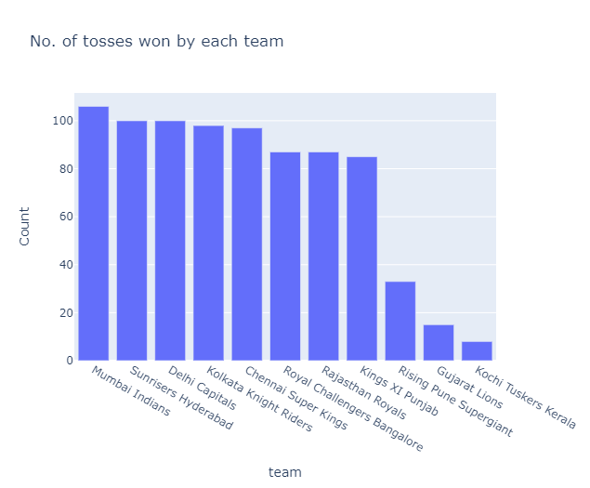
Team which has won the most of the tosses
Mumbai Indians have won the most tosses 106 times and followed by both Sunrisers Hyderabad and Delhi Capitals have won the tosses 100 times

Slide 22
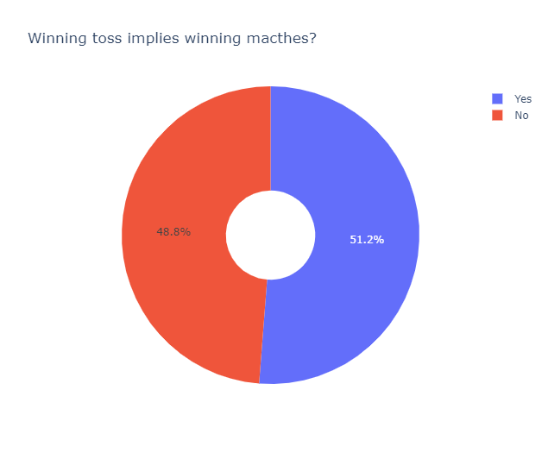
Does winning the toss implies winning the match
The pie chart imply that winning the toss has no relation in winning the match.

Slide 23
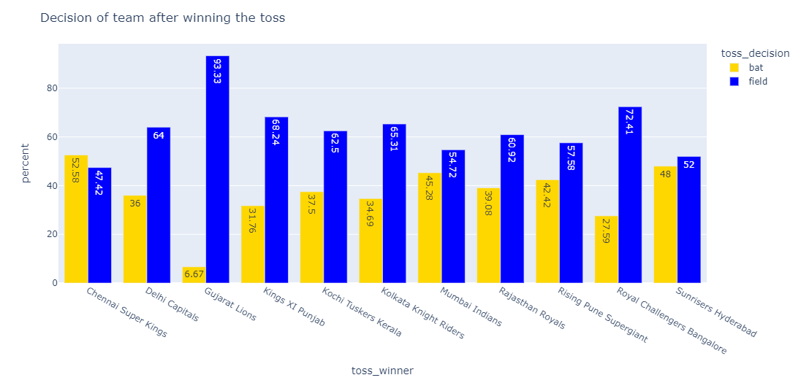
Decision of team after winning the toss
It is clear that most of the teams who won the toss chose to field first.

Slide 24
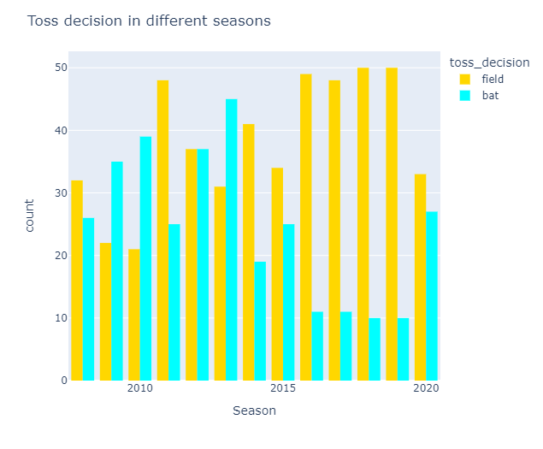
Toss decisions across seasons
Season wise on the years 2016, 2017, 2018, and 2019 teams have consecutively selected to field

Slide 25
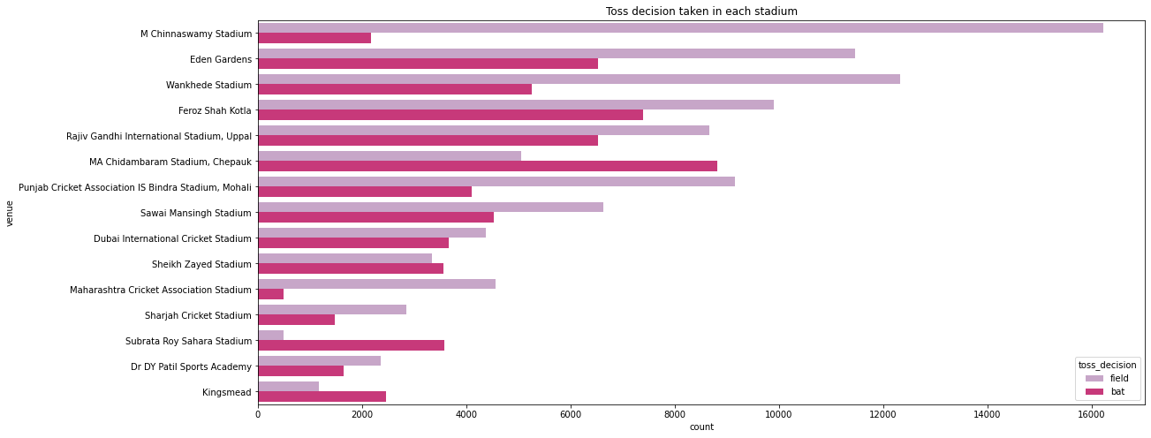
Toss decision in each venue
we could infer most of the teams who played in M Chinnaswamy stadium chose to field first

Slide 26
As soon as, we talk about any game there rises a question, does winning the toss implies winnings the match? This analysis has proven this statement is totally wrong
We can also infer from the graph that the toss decision for most of the teams in M. A. Chidambaram Stadium, chepuk, Chennai is batting first. But in the usual case, they go ahead with fielding if it was any other stadium this is due to the pitch and weather in Chennai

Slide 27


Slide 28
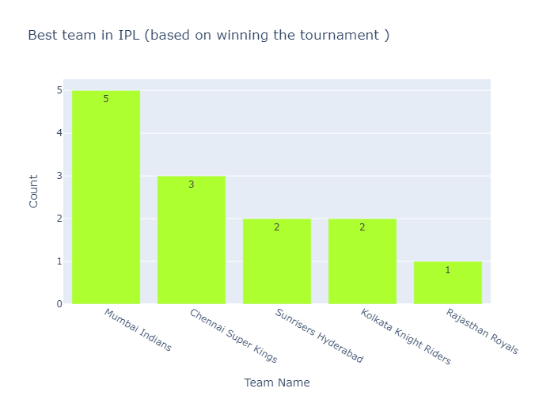
Recursive tournament winners
The team Mumbai Indians won 5 tournaments and secondly the team Chennai Super Kings won 3 tournaments.

Slide 29
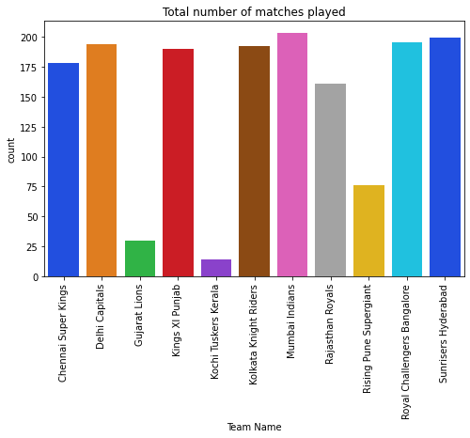
Total number of matches played by a team
Mumbai Indians have played the most matches(203), followed by Sunrisers Hyderabad (199)

Slide 30
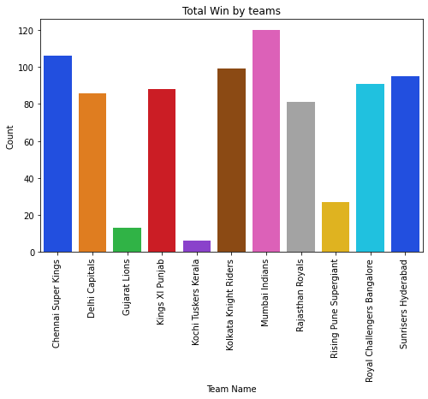
Most number of wins
Mumbai Indians had won the most matches(120), followed by Chennai Super Kings (106)

Slide 31
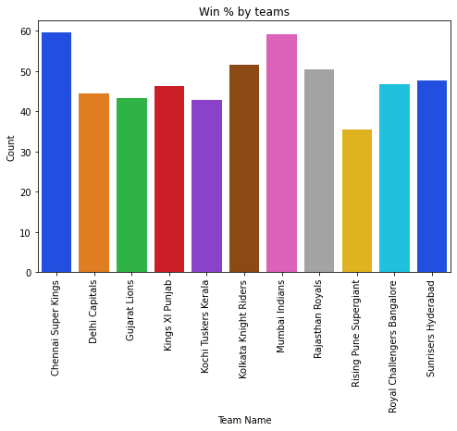
Total win %by each team
Chennai Super Kings have the highest win % of 59.5, followed by Mumbai Indians (59.11) and Kolkata Knight Riders(51.56).

Slide 32
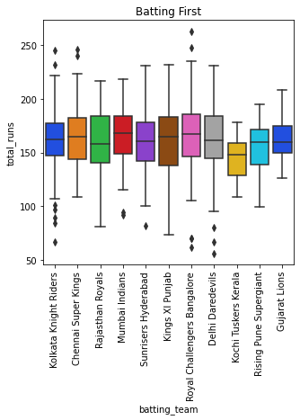
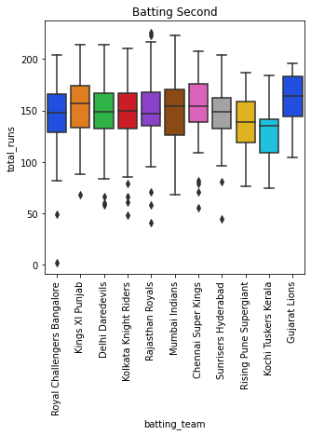
Innings-wise comparison
Royal Challengers Bangalore median values are better than other teams while batting first and Gujarat lions median is good in second innings

Slide 33
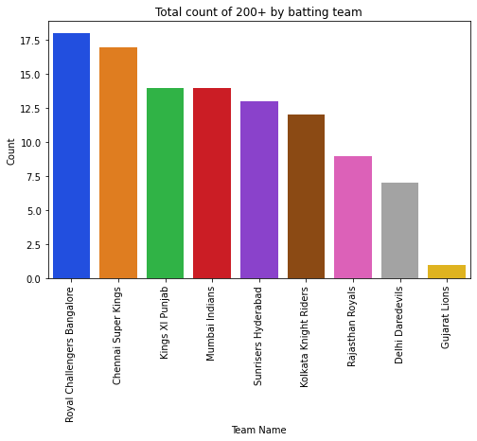
Teams who scored 200+ runs
200+ runs were scored by Royal Challengers Bangalore in 18 matches, followed by Chennai Super Kings who scored 200+ runs in 17 matches

Slide 34
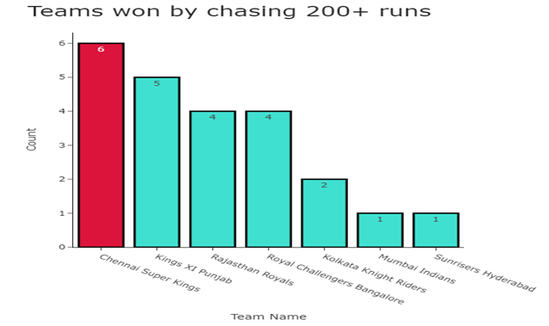
Teams won by chasing 200+ runs
Chennai super kings won 6 matches by chasing 200+ runs

Slide 35
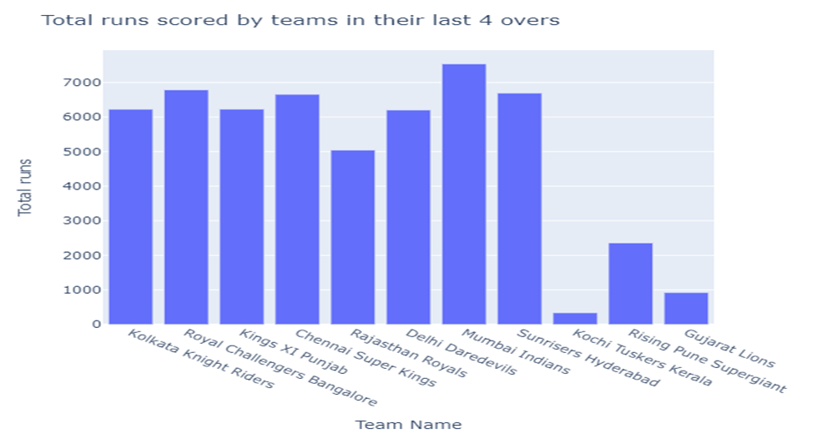
Teams performance in the last four overs
Mumbai Indians have scored the highest runs in their last four overs followed by Royal Challenges Bangalore

Slide 36
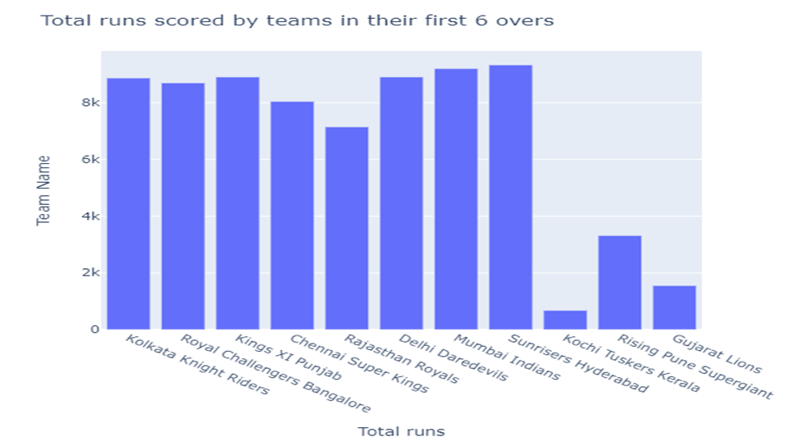
Teams performance in power play
Sunrisers Hyderabad has scored the highest runs in the first six overs followed by Mumbai Indians

Slide 37
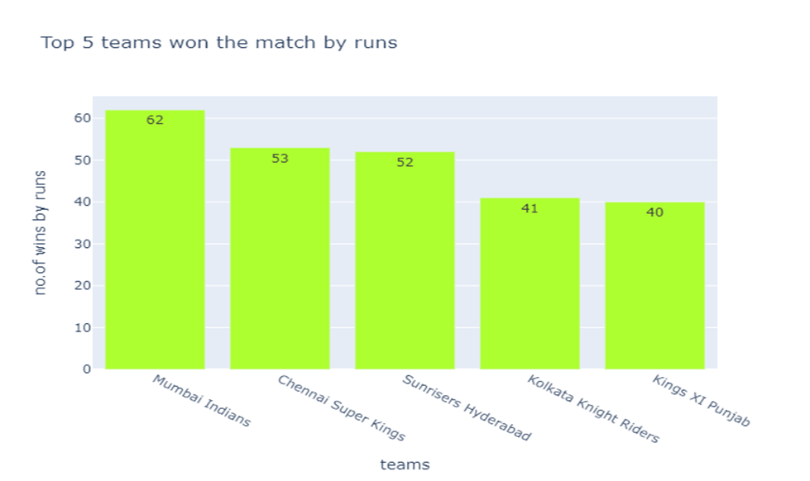
Top five teams which won matches by runs
Mumbai Indians won 62 matches followed by Chennai super kings won 53 matches

Slide 38
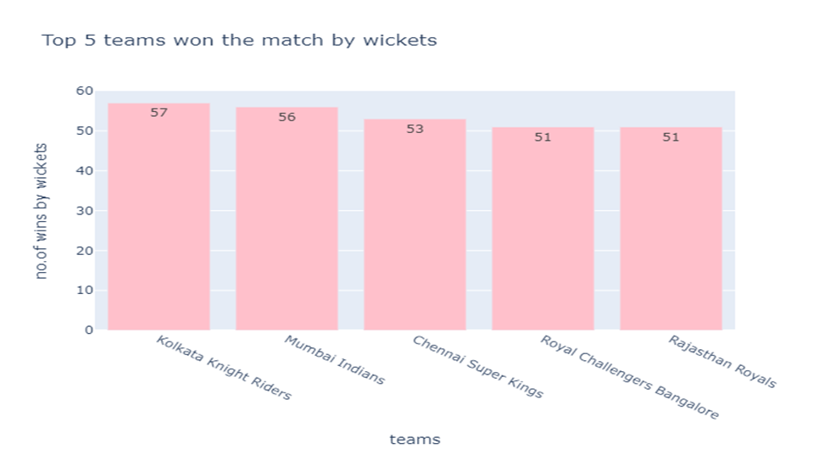
Top 5 teams which won matches by wickets
Kolkata knight riders won 57 matches followed by Mumbai Indians won 56 matches

Slide 39
Mumbai Indians
Mumbai Indians have played the most number of matches when compared to other teams but their winning percentage is slightly low when compared to Chennai super kings. They are best at batting and also in bowling but they need to be focused on getting 200+ runs
Chennai Super Kings
The winner percentage of Chennai Super Kings is high and in 17 matches they got 200+ moreover they won 6 matches by chasing the 200+ runs. Their batting and bowling order is also good

Slide 40
Royal Challengers Bangalore
Royal Challengers Bangalore got 200+ runs in 18 matches which is the highest among all the teams. Their batting order is strong but bowling is quite weak. When compared to their team this team has chosen to field more while top teams like Mumbai Indians and Chennai super kings maintain their fielding and batting percentage. This may be the place where they have to focus on

Slide 41
Sunrises Hyderabad
Sunrises Hyderabad is best at using the power play but in the flow of the match they lose consistency
Kolkata Knight Riders
Kolkata Knight Riders have won more matches my wickets this shows that their bowling team is strong. But their batting order is weak

Slide 42


Slide 43
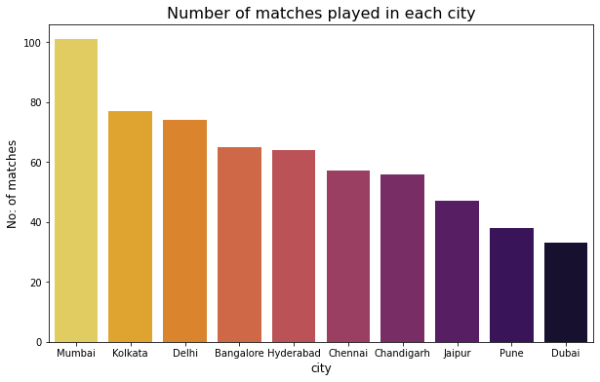
Number of matches played in each city
This graph says most number of matches is played in Mumbai

Slide 44
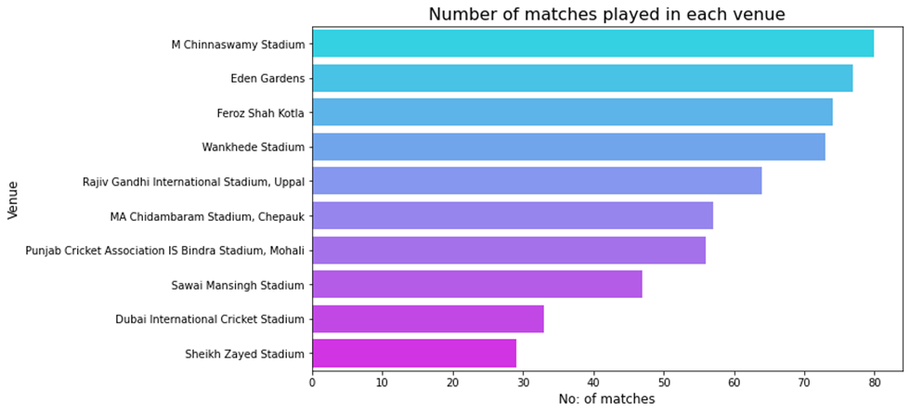
Number of matches played in each venue
M Chinnaswamy stadium has hosted the highest number of matches compared to other stadiums.

Slide 45
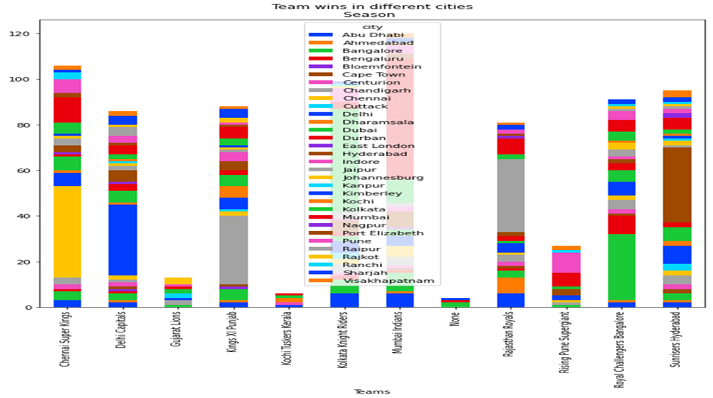
Wins of teams in home city vs others
we can infer that there is more win while the team is playing in their home ground only in 2020 and 2009

Slide 46
Wins on their home ground are very high because of the support and encouragement the team gets on their home ground and they are practicing in the same ground for a long time these made the team members to known about the pitch condition very well this may be the reasons for their win

Slide 47


Slide 48
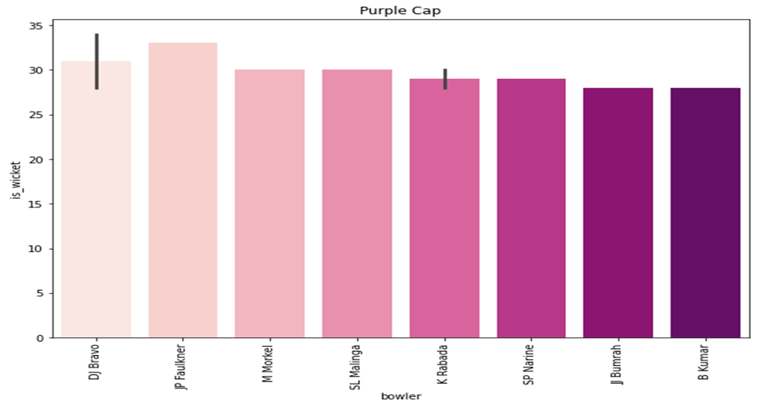
Top player in purple cap
Dwayne Bravo won the Purple Cap award in 2013, with 32 wickets.

Slide 49
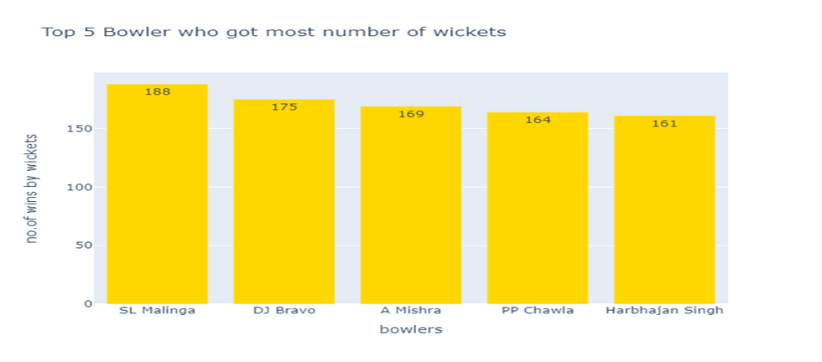
Top five bowlers who got most number of wickets
SL Malinga got more wickets(188) when compared to other bowlers

Slide 50
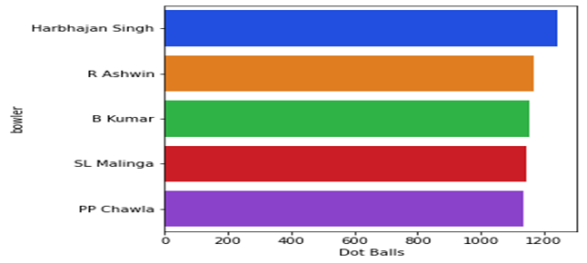
Most dot balls
Harbajan singh has got most number of dot balls

Slide 51
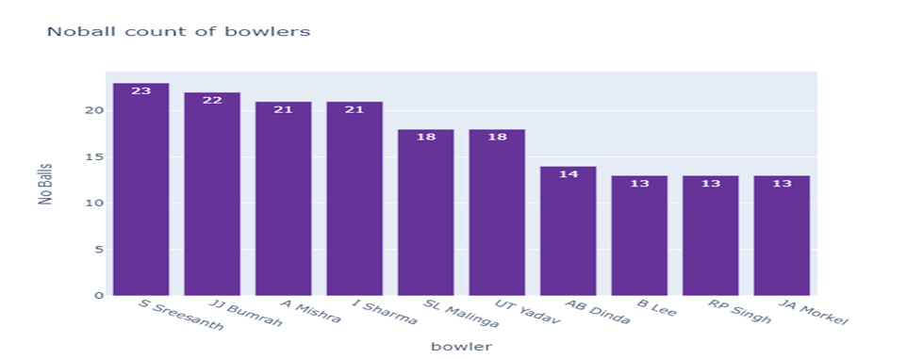
No ball count of bowlers
S Sreesanth’s no ball count is high when compared to other bowlers

Slide 52
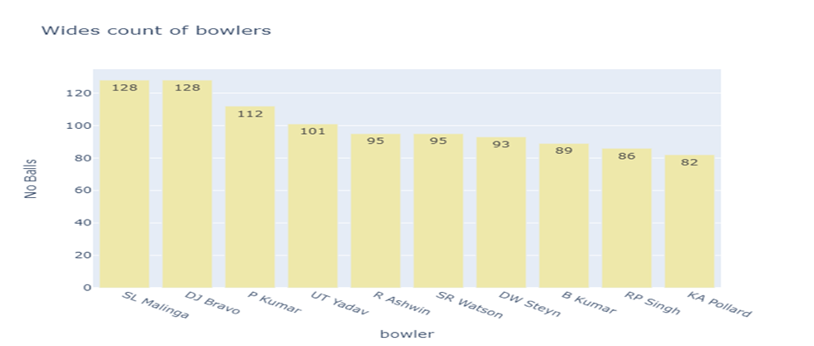
Wides count of bowlers
SL Malinga and DJ Bravo have given the same number of wides

Slide 53
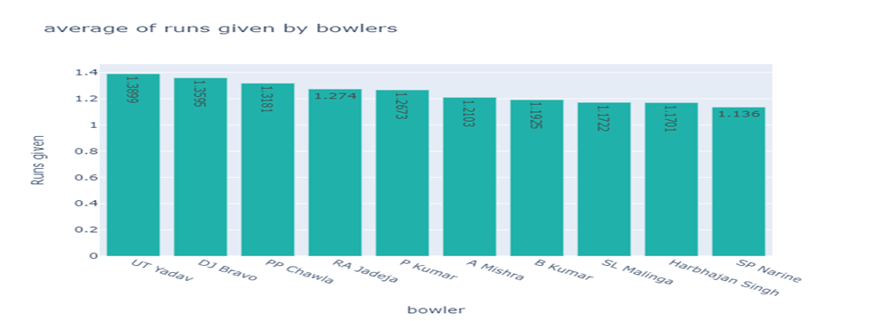
Average of runs given by the bowlers
UT Yadav has highest average run

Slide 54
DJ Bravo, D Faulkner, M Morkel, SL Malinga, and K Rabada are those who got the purple cap with the most number of wickets
In which there is a close competition between DJ Bravo and SL Malinga as these are the one who occupied the top 2 most wicket taking bowlers. But in further analysis, we found that SL Malinga has given more wide balls, no balls, and dot balls
The only drawback of DJ Bravo is his average run given rate is high when compared to SL Malinga. Since all the aspects are important for bowlers we cannot conclude who is best

Slide 55


Slide 56
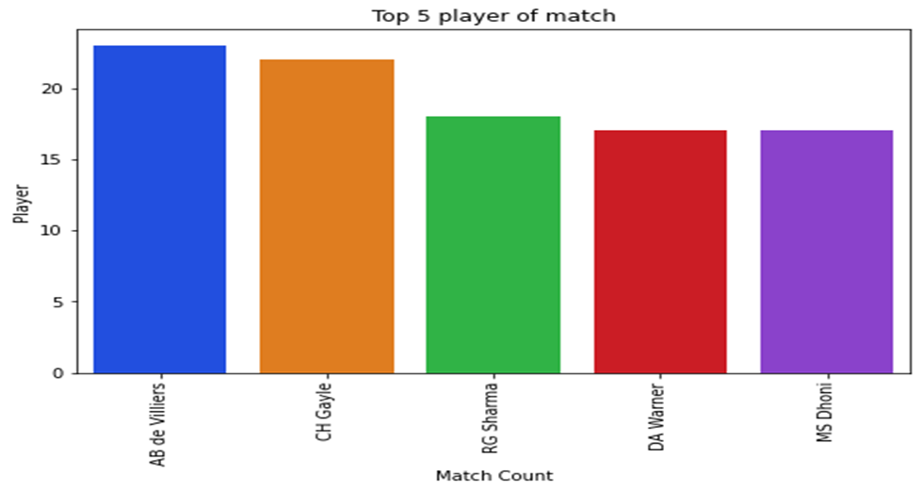
Most valued player
AB de Villiers has won player of match most number of times(23), followed by CH Gayle (22).

Slide 57
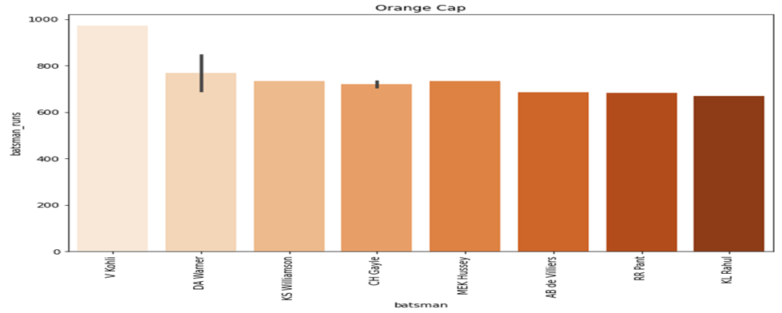
Top player in orange cap
In 2016, Virat Kohli won the orange cap. He scored 973 runs and represented RCB.

Slide 58
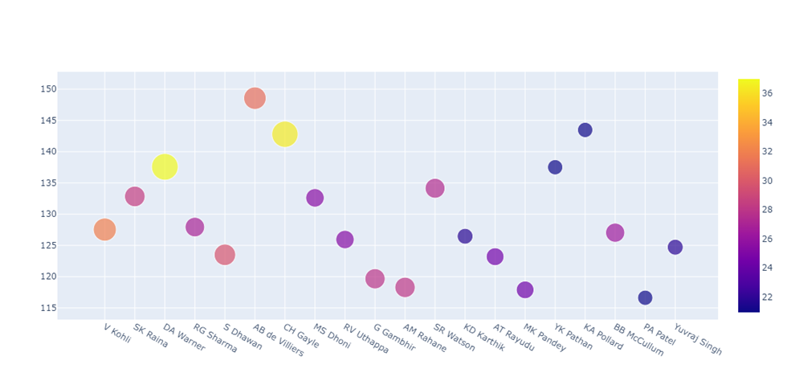
Top 20 batsman strike rate and average score
Virat Kholi has more is first among top 20 batsman based on total run but AB de Villiers has highest strike rate and DA Warner and CH gale has highest average score

Slide 59
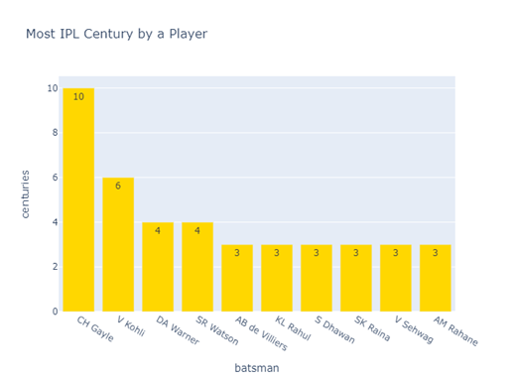
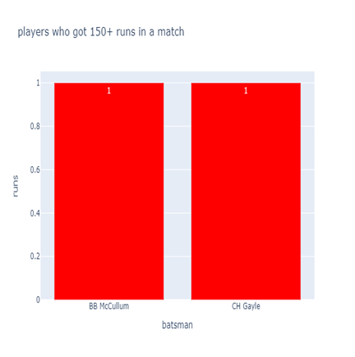
Most IPL centuries by player
CH Gayle hit 6 century in the period 2008-2020.only BBMcCullum and CH Gayle crossed 150+ runs

Slide 60
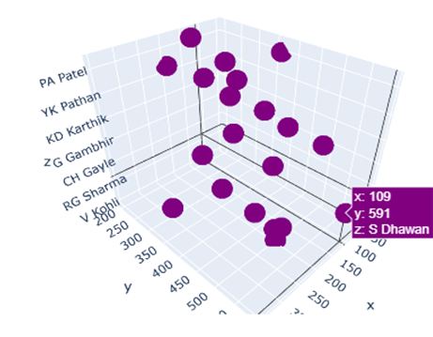
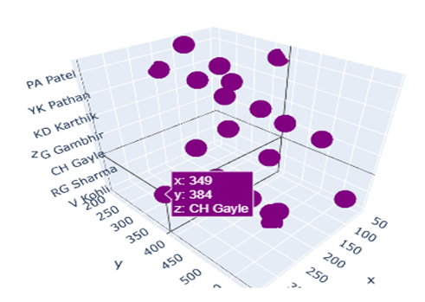
Player who has hit the most number of boundaries and sixes
CH Gayle has hit the most number of sixes and S Dhawan has hit the most number of boundaries

Slide 61
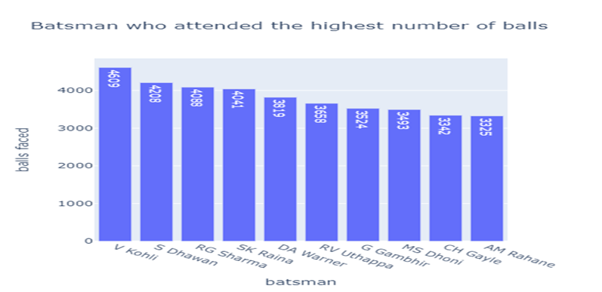
Batsman who faced the highest number of balls
Virat Kohli(4609) played the most balls followed by S Dhawan(4208). we can note that most of them are open batsmen

Slide 62
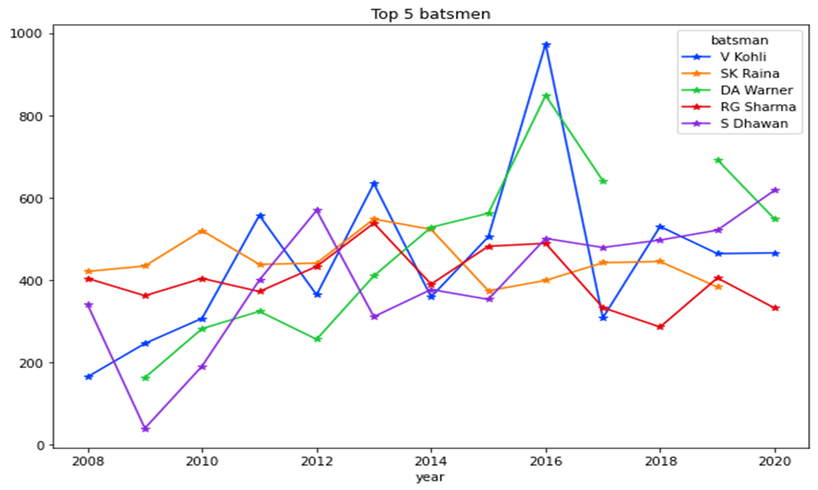
Top five batsman analysis
we can also notice that V Kohli hitting hikes in alternative years especially his runs is near to 1000 in the 2016 IPL

Slide 63
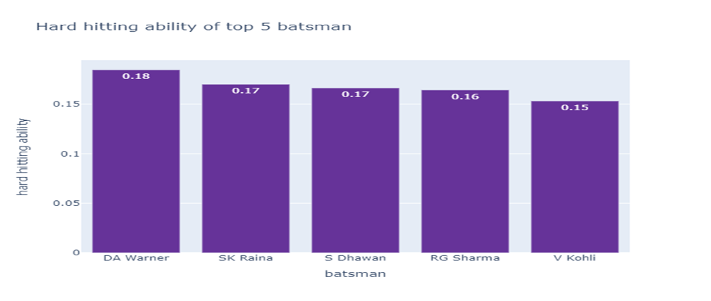
Hard hitting ability of batsman
DA Warner has high hitting ability

Slide 64
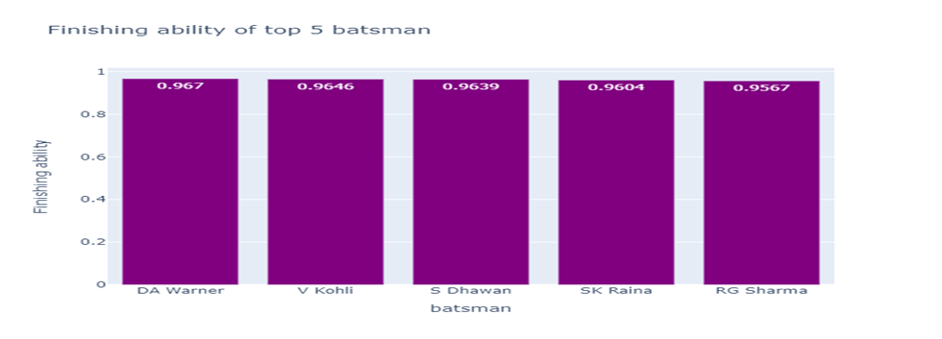
Finishing ability of top 5 batsman
DA Warner has the finishing ability too.

Slide 65
AB de Villiers, RG Sharma, CH Gayle, and DA Warner are those who got man of the match more times
AB de Villiers, CH Gayle, and DA Warner are also included in the list of members who got the orange cap with more runs but Virat Kohli was the one who got the number one position in this aspect
Since the main job of the batsman is taking runs, based on this criteria we found the top 5 batsmen in which Virat Kholi is in the top and we can notice his performance is good in alternative years

Slide 66
In addition to that S Dhawan has shown a drastic improvement from 2009 to till now and he is also the one who hit the most number of boundaries
Further when we calculated the hard-hitting ability and finishing ability of the top 5 batsmen since these are considered as the matrix of batsmen. We found that DA warner is first in both
Though Virat Kholi is the one who got the most number of runs his team didn’t win the match even once

Slide 67
Even though DA Warner is banned for a year this cumulative performance is still high and he is good in three aspects which is more when compared to others so we can conclude that DA Warner has shown extraordinary performance in IPL (2008-2020)

Slide 68
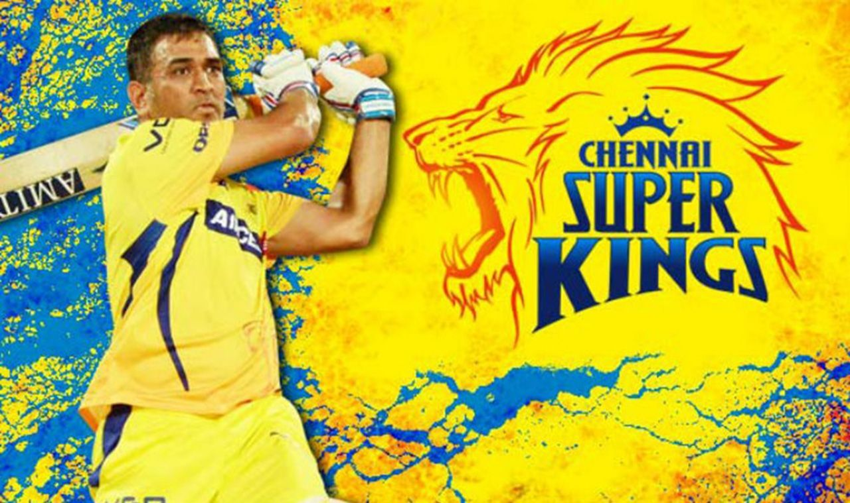
Analysis on Mahendra Singh Dhoni

Slide 69
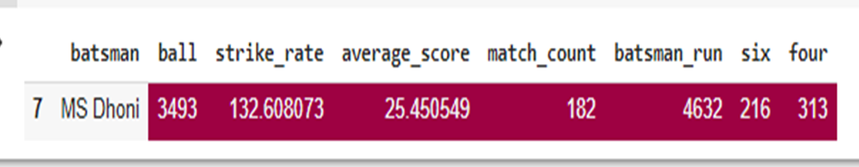
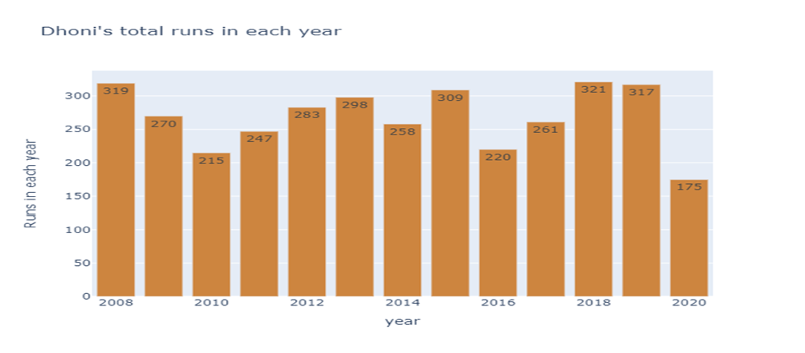

Slide 70



Slide 71



Slide 72


Slide 73
He hit 321 runs in the 2018 IPL match which is his highest total runs score when compared to other seasons
His highest boundaries score is in 2008 with 38 boundaries followed by 2013 with 32 boundaries
His highest sixes score is in 2018 with 30 sixes followed by 2013 with 25 sixes
AB de villers (4 times )are the ones who took his wicket the most
Bowlers Z Khan pp ojha is the one who took dhoni's the most
His best partner is SK raina

Slide 74



